Slide 1

CAR RENTAL APP
~ Rent wheels

Slide 2
Team Members
L V V Raghava Pullaiah
Zahur Hussain
2593589
2593794
1
2
3
4
Madan Kumar Reddy
Rooyel Mukherjee
2593484
2593793

Slide 3
CONTENT
Environment
Screenshots
Abstract
03
Conclusion
01
05
07
02
04
06
08
Introduction
Technologies
used
Data Flow
Junit Testing

Slide 4
INTRODUCTION
Rent Wheels is a car rental service for everyone.​
It is user- friendly, thus helping in better utilization of the resources. This project offers the best of services-both in terms of man and machine.​
It offers the online car rental service for travel agencies.
​It offers the best of rates and include the different categories of cars from luxury to budget. ​
Our Car Rental service will also provide Accumulate loyalty points for Regular Customers.​

Slide 5
ABSTRACT
The Car Rental System is being developed for customers so that they can book their vehicles from any part of the world. This application takes information from the customers through filling their details. A customer being registered in the website has the facility to book a vehicle which he requires.
Car rental management system is a project which aims in developing a computerized system to maintain all the daily work of Car Rental .
It also has a facility of admin login through which the admin can monitor the whole system . It also has facility of an online notice board where Admin can put up information about the cars available in the exhibition and their prices and updating all data that go through the rental process.
It has also a facility where user after logging in their accounts can see list of cars and its price and Availability of the car.
Overall, this project of ours is designed to help anyone make it easier during the process of renting a car in the best possible way, as well as reducing human efforts and obtaining the best.

Slide 6
Technology Used
HTML : Page layout has been designed in HTML.
SCSS : SCSS has been used for all the designing part.
TS : TypeScript is a primary language for Angular application development.
Java : All the business logic has been written in Java.
Angular CLI : Command-line interface tool that we use to initialize.
MySQL : MySQL database has been used as database for the project.
Hibernate : Used for object table mapping.
Spring-boot : Server side setup.
Post-man : Postman is an API platform for building and using APIs

Slide 7
Environment
Intel hardware machine (PC P4-2.26 GHz, 8GB RAM, 40 GB HDD)
Database – MySQL
MySQL Connector
Node Version 18.20.2
JDK 17
Eclipse IDE or Spring Tool Suite
Angular Version 16.2.4

Slide 8

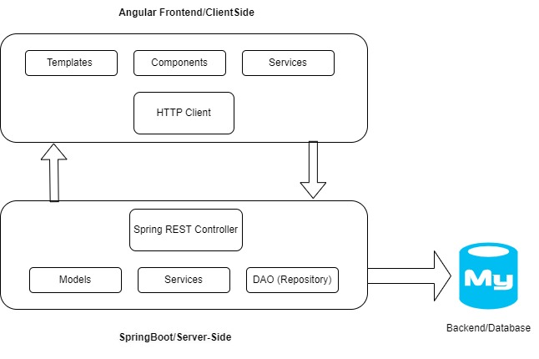
Data Flow

Slide 9
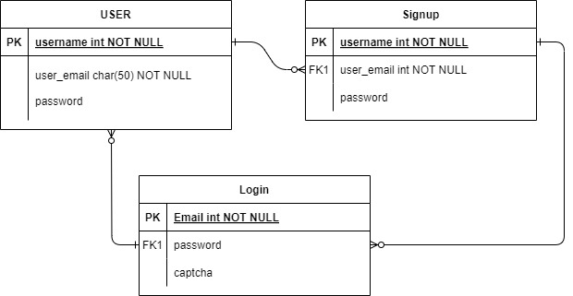
ER Diagram for User

Slide 10
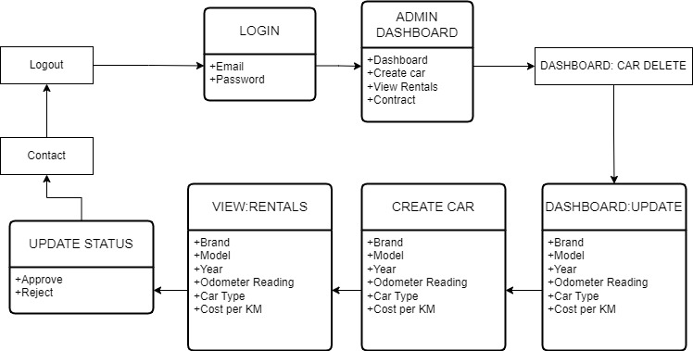
ER Diagram for Admin

Slide 11
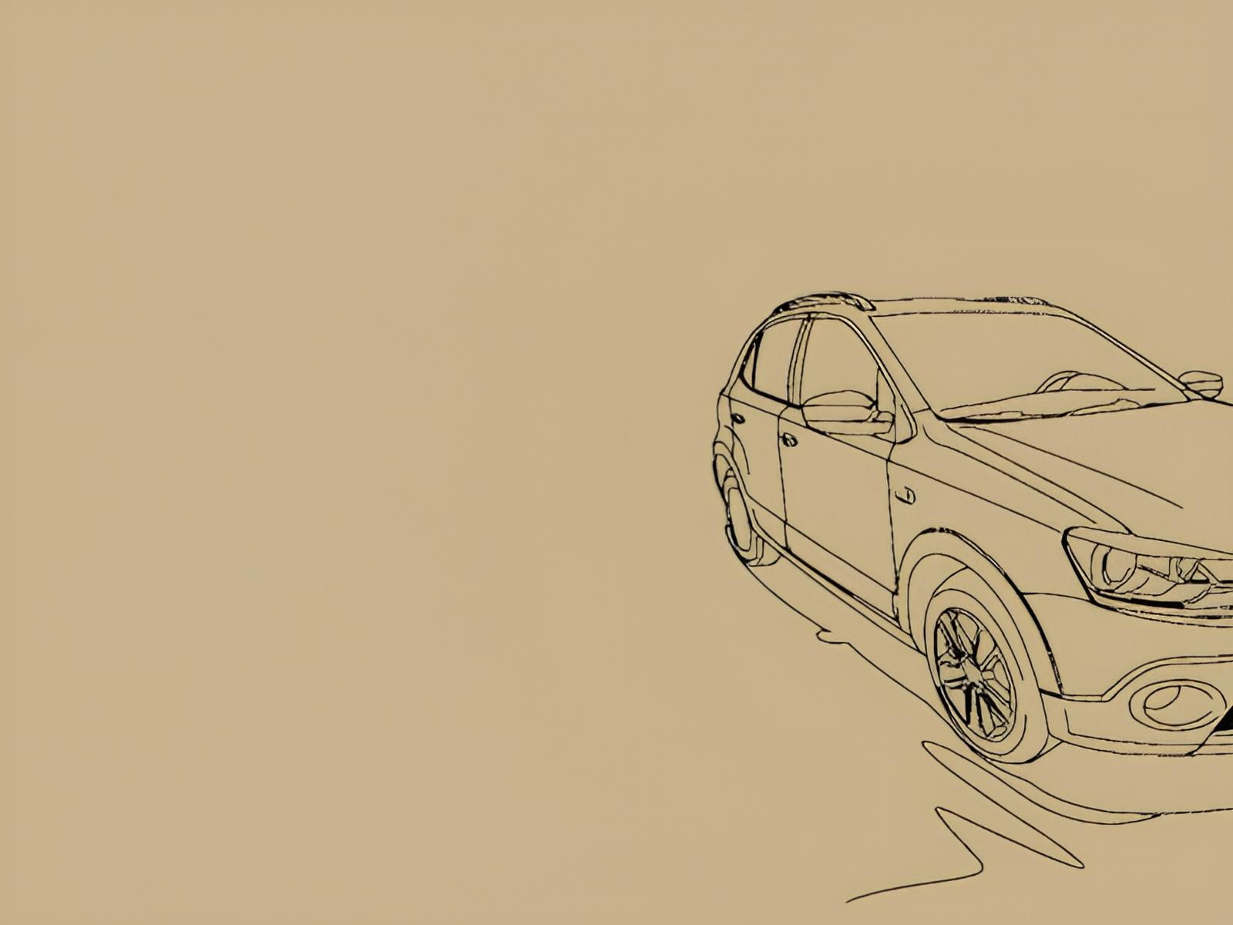
Screenshots

Slide 12
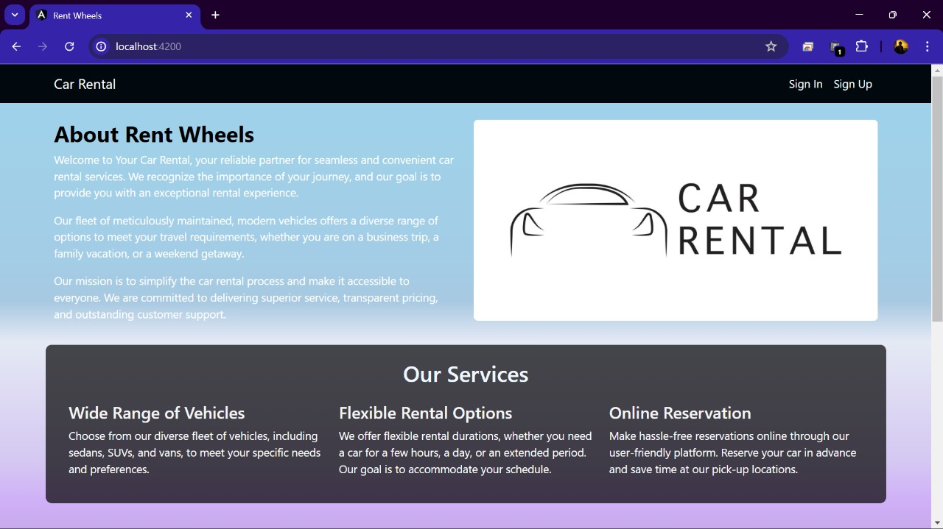
Home Page:

Slide 13
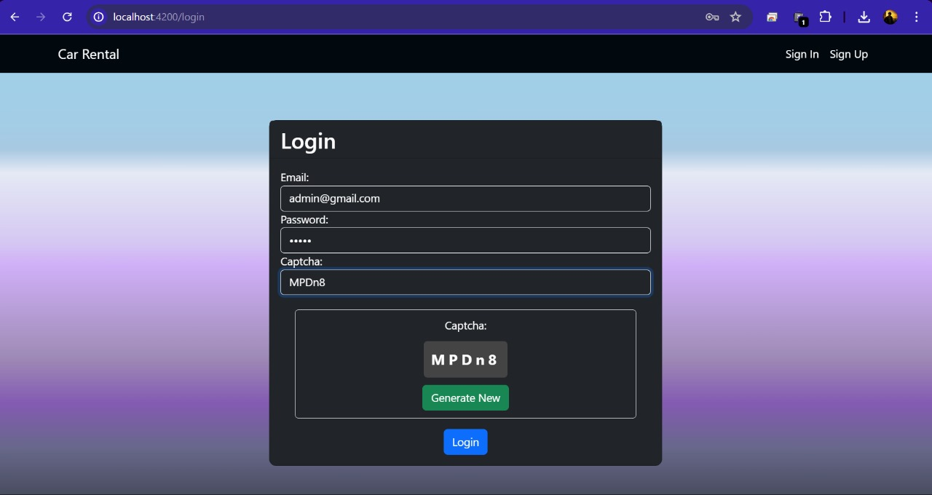
Admin Login:

Slide 14
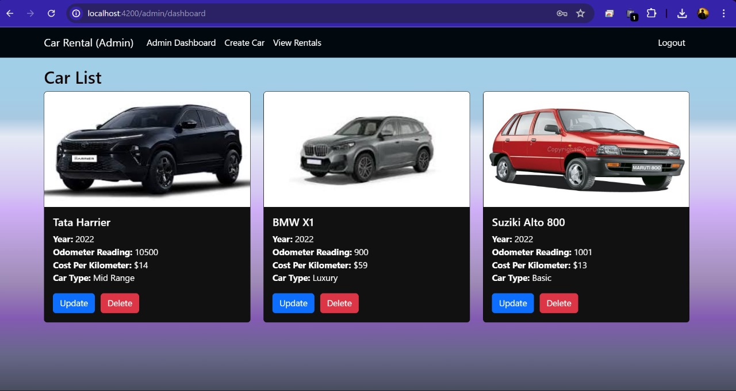
Admin Dashboard:

Slide 15
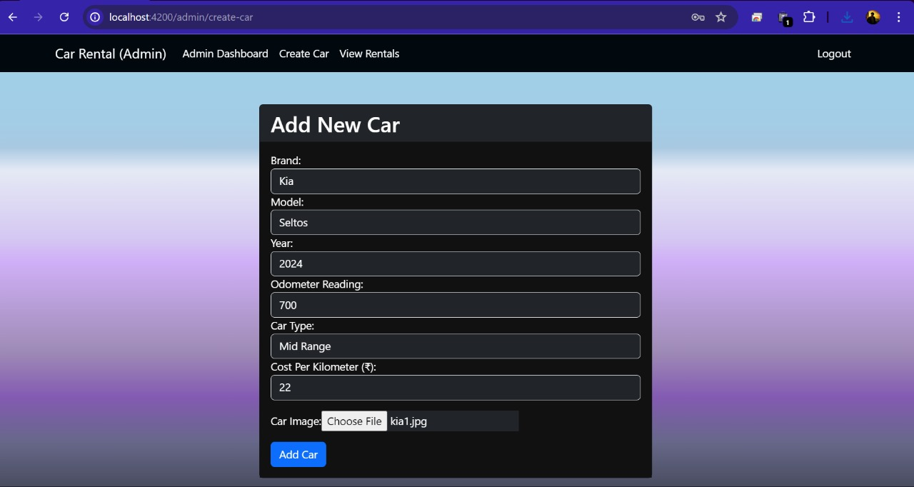
Create a New Car :

Slide 16
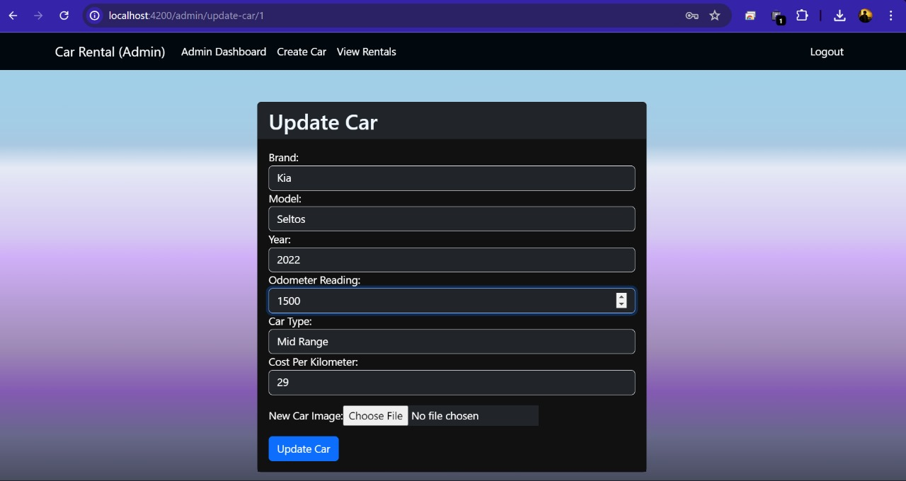
Update Car :

Slide 17
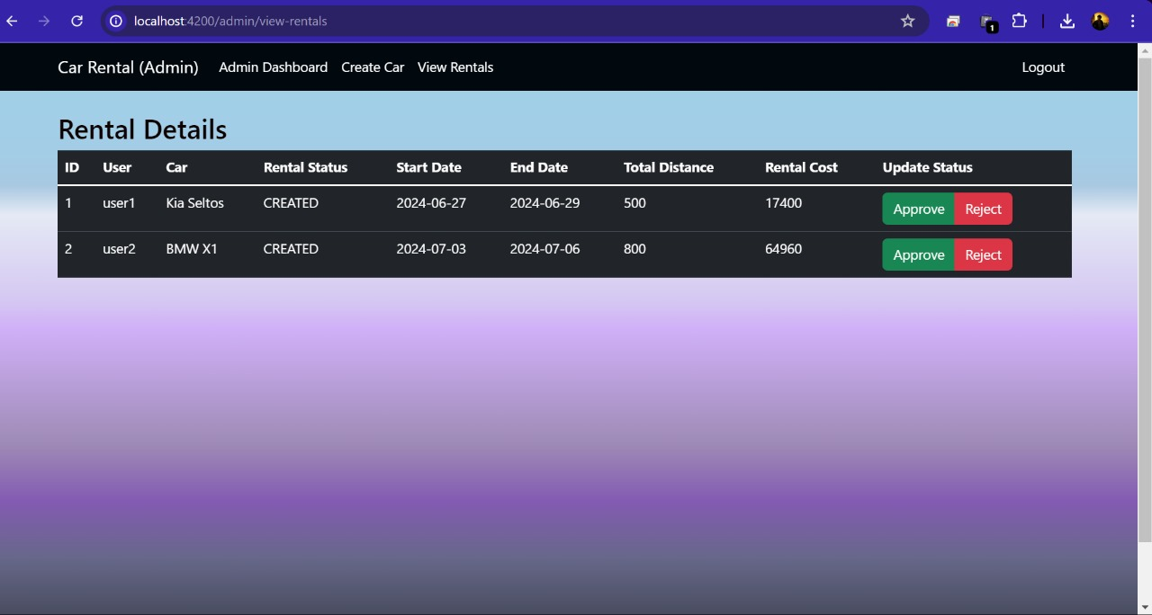
View Rentals of Admin :

Slide 18
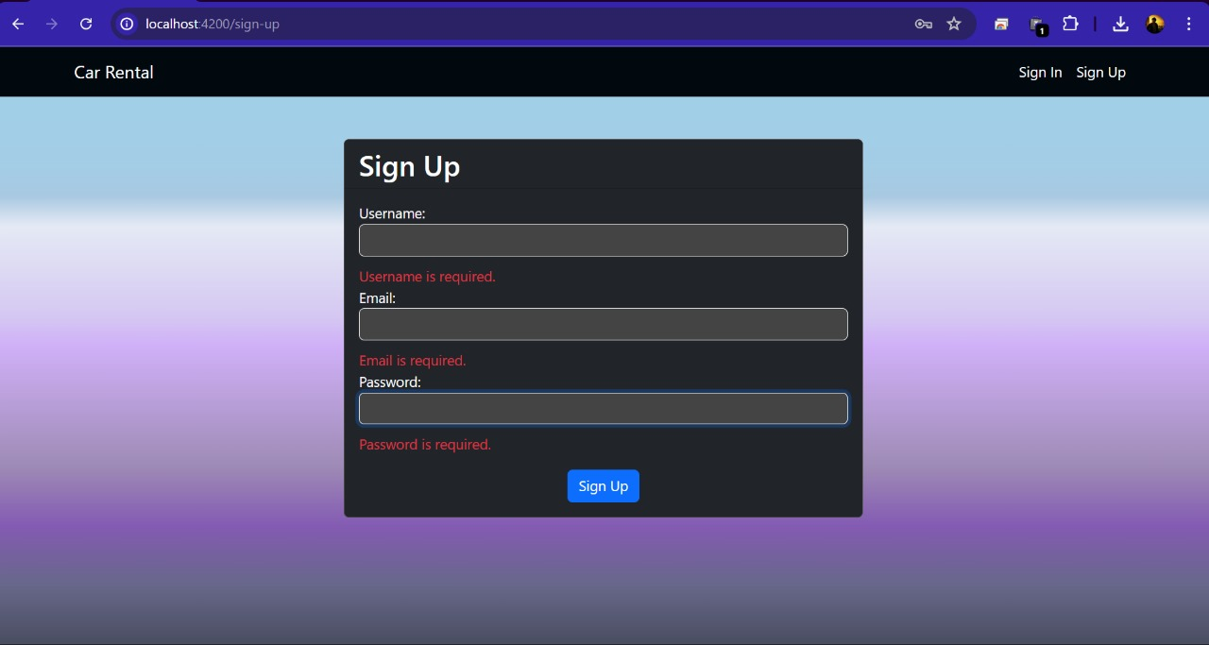
Sign Up for customer:

Slide 19
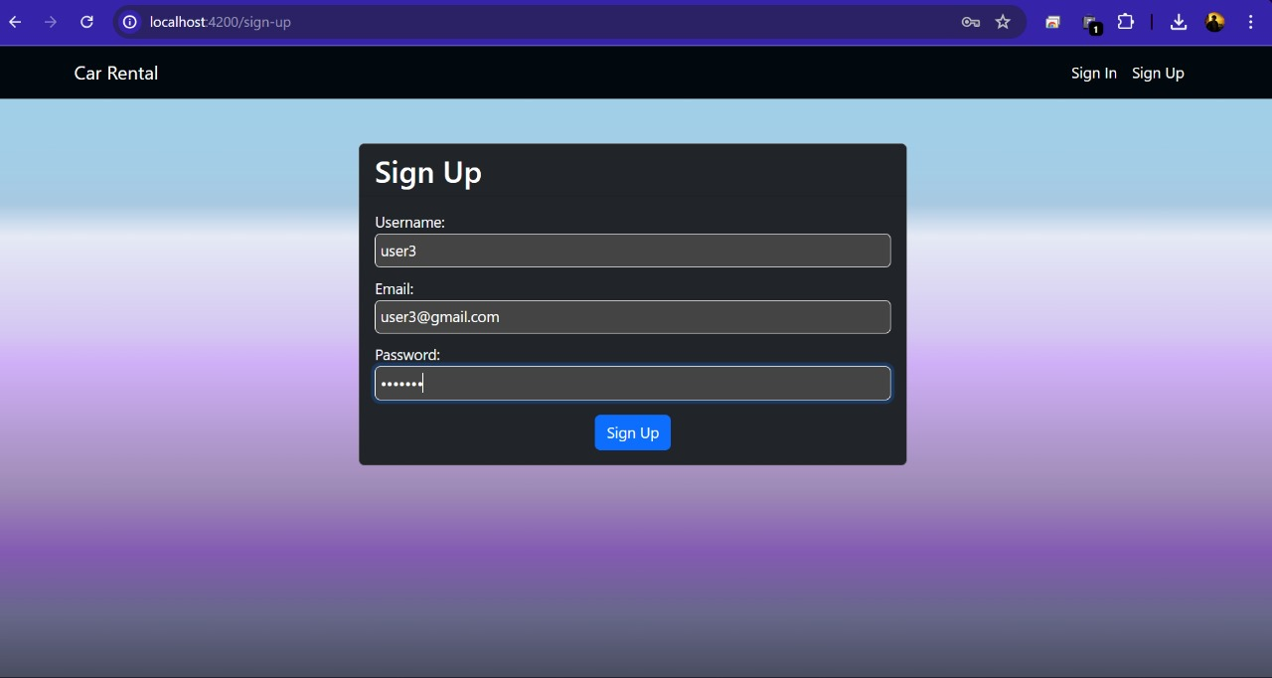
Sign In:

Slide 20
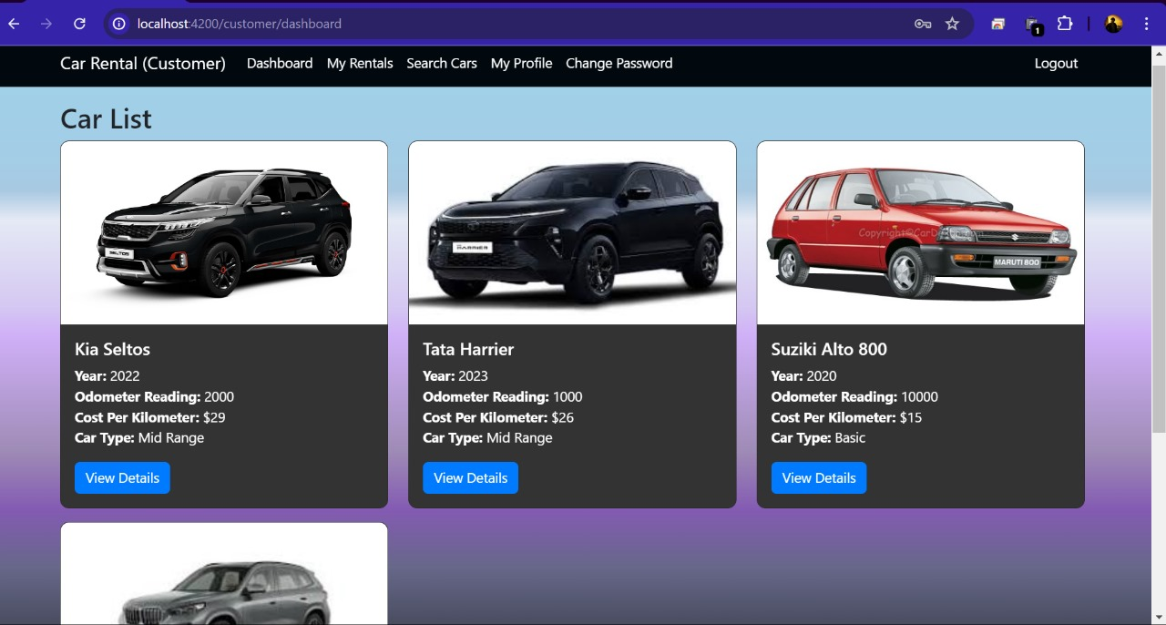
User Dashboard :

Slide 21
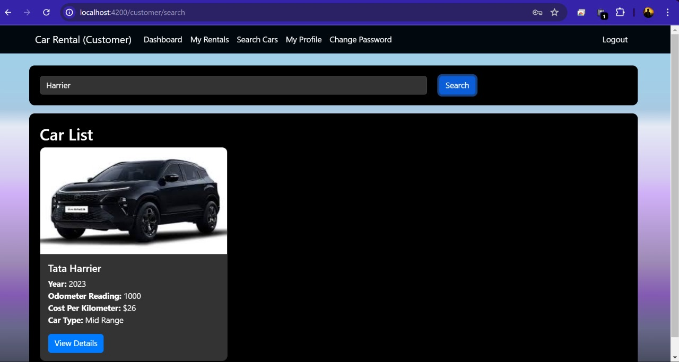
Search Car by Model:

Slide 22
View Details of Car and Booking:
In this scenario renting a car, after clicking on view details they should see information such as the year of the car, odometer readings, cost per kilometer, and car type.
When the customer books the car, they need to provide the starting date to rent a car and the ending date of the car rental. The system should also display the odometer starting reading to the customer. After entering all the necessary details, the customer should be able to Book the car.

Slide 23
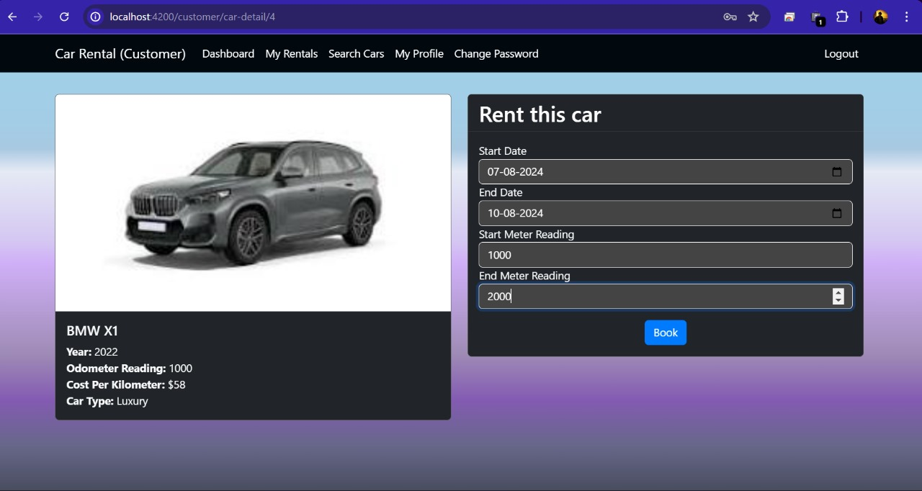
View Details of Car and Booking:

Slide 24
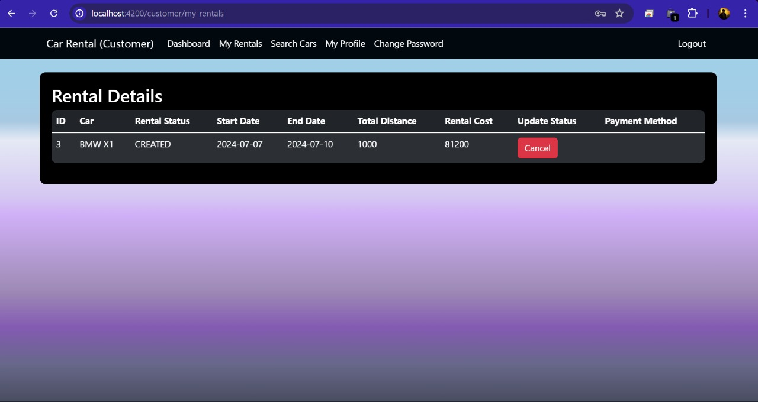
User Rentals:

Slide 25
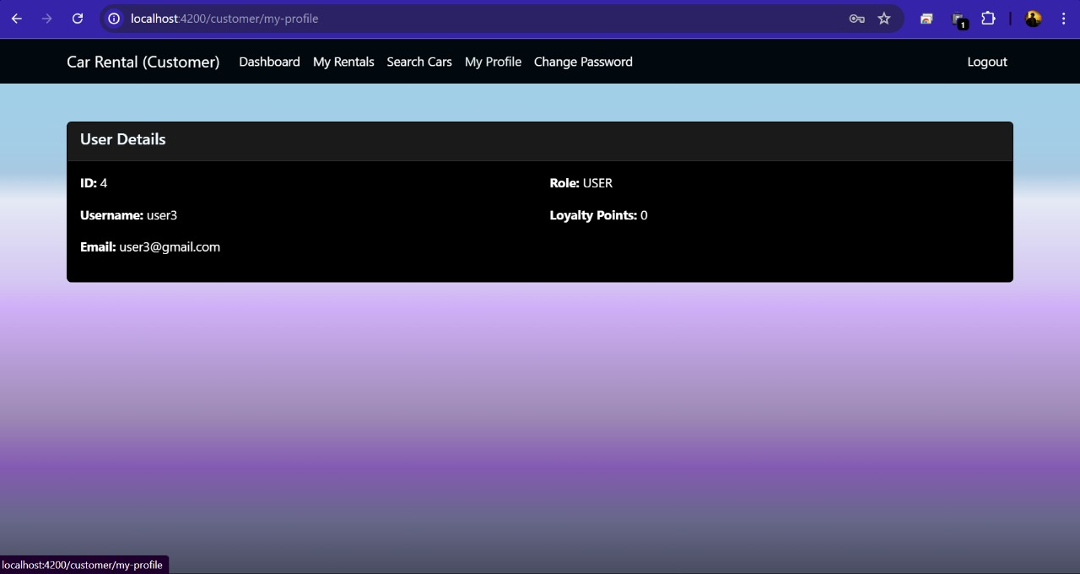
User Profile:

Slide 26
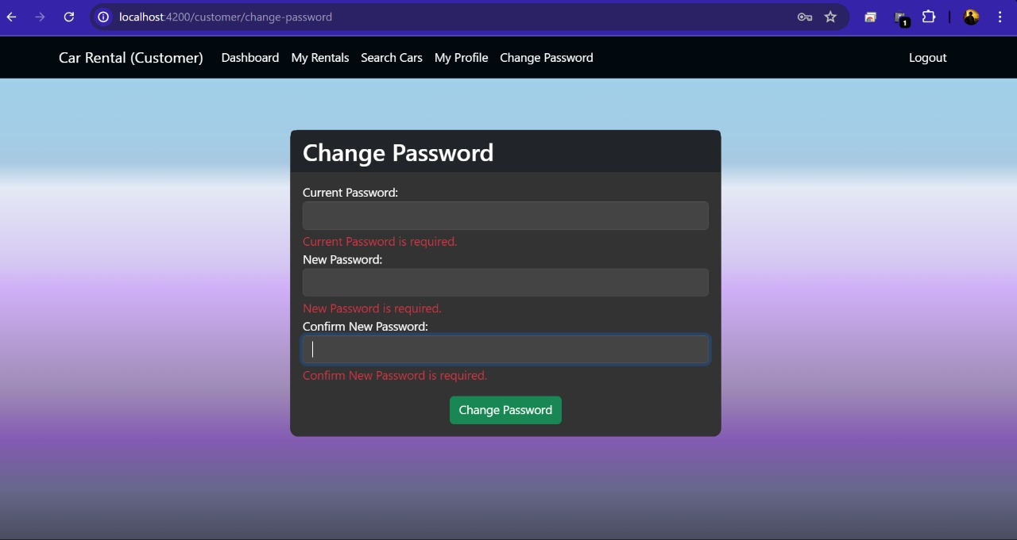
Change Password For User:

Slide 27
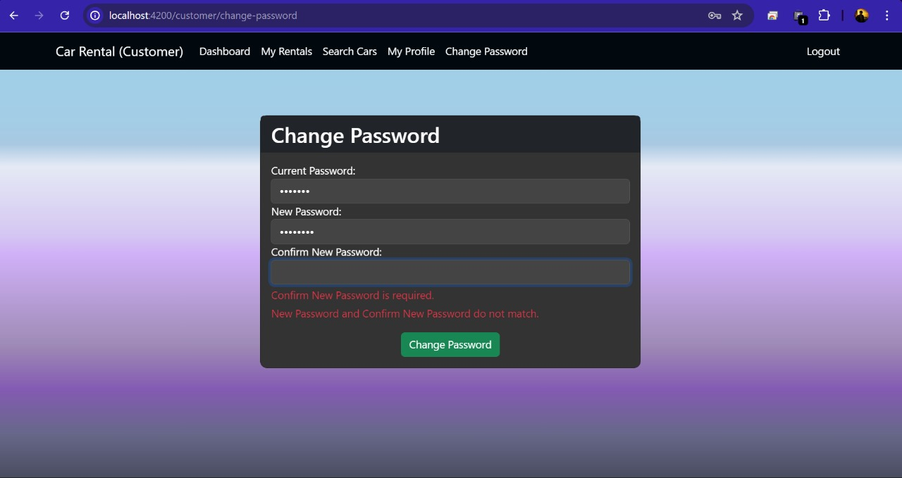
Confirm New Password:

Slide 28
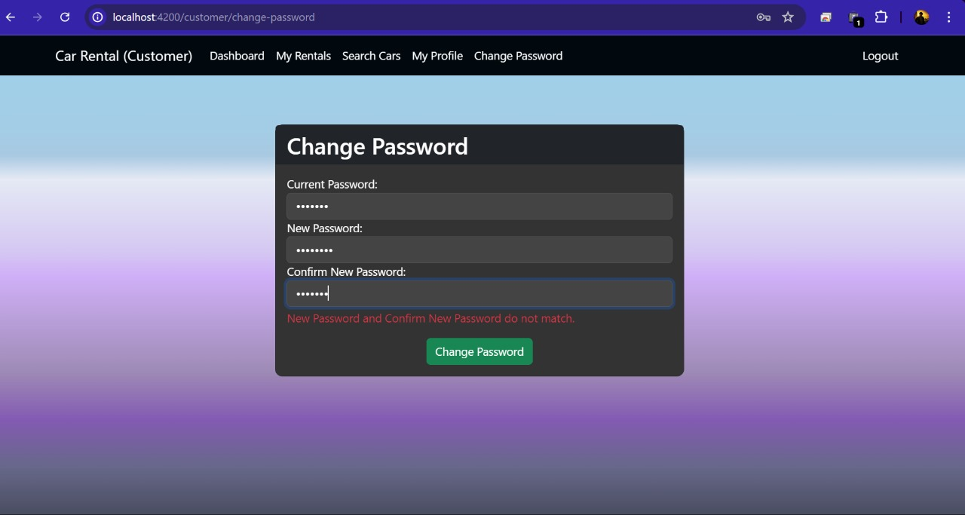
New Password Validation:

Slide 29
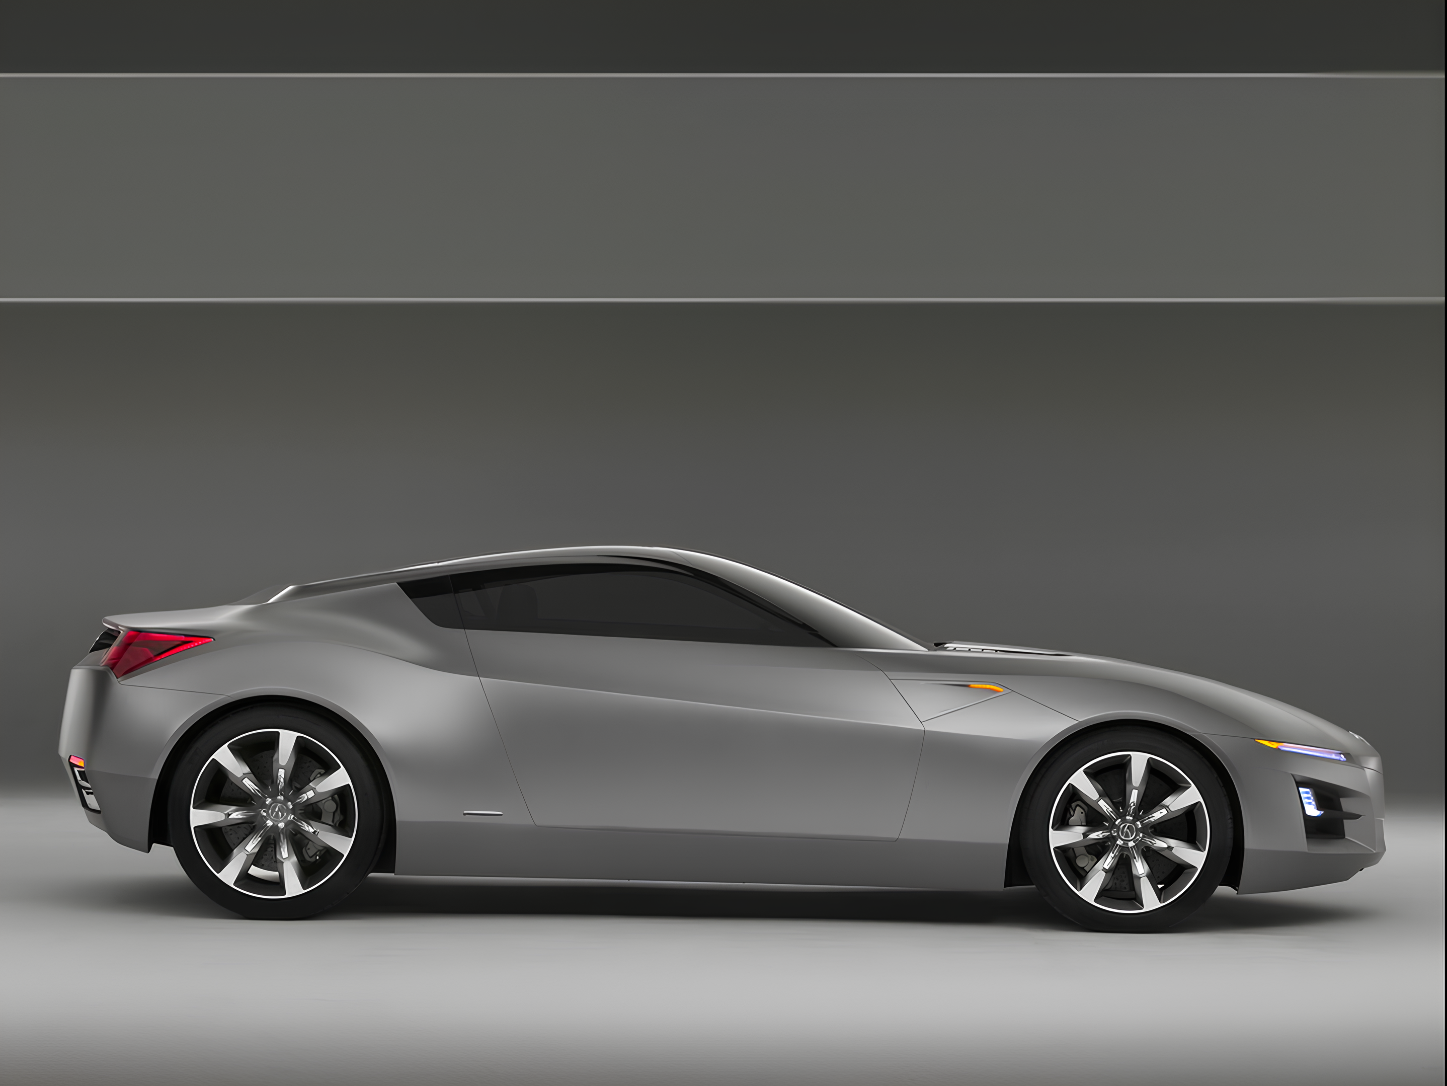
API Testing using Postman

Slide 30
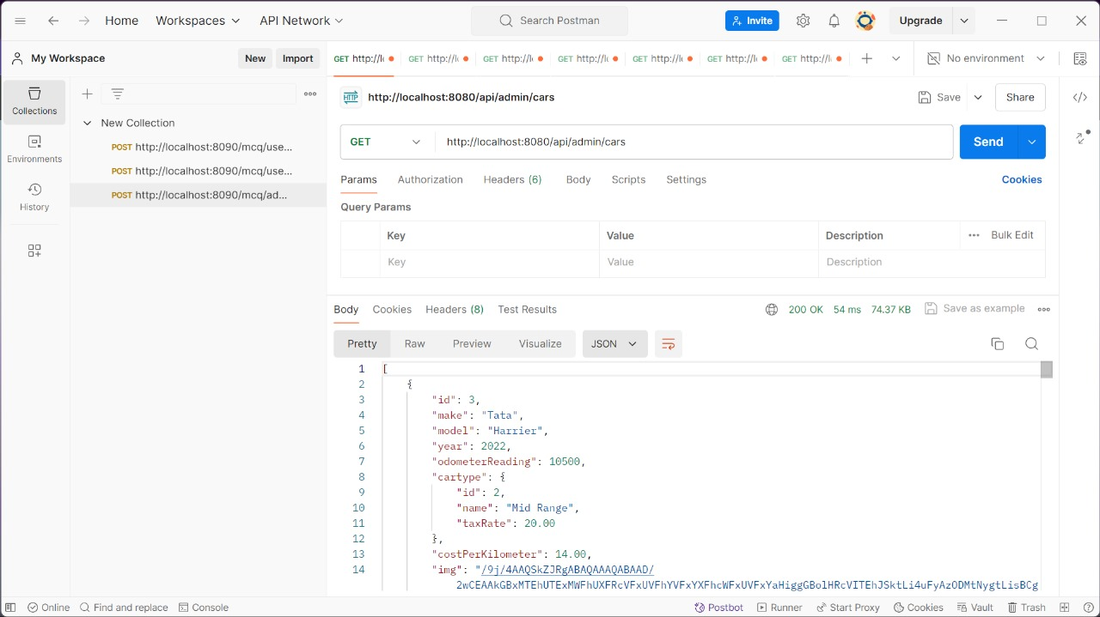
Car-details:

Slide 31
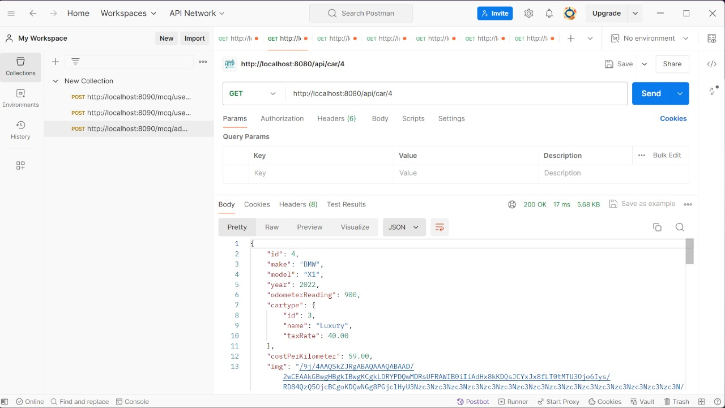
Get car by id:

Slide 32
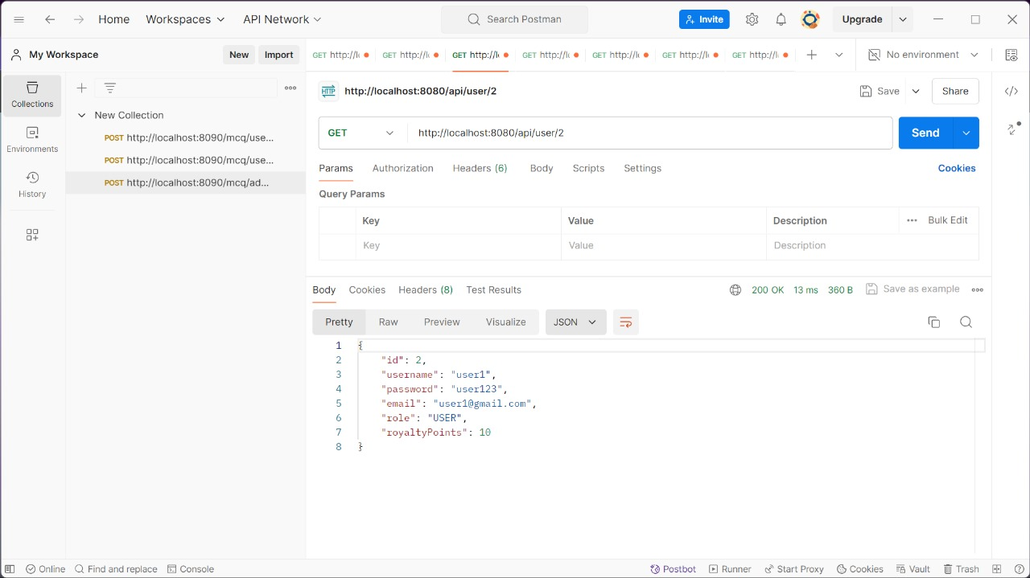
Finding user by id:

Slide 33
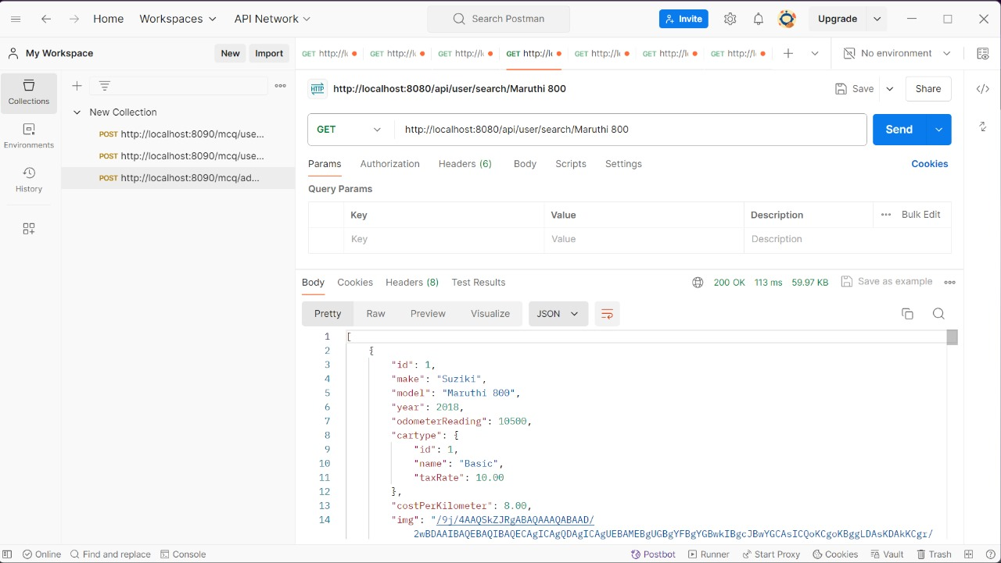
Search car by model:

Slide 34
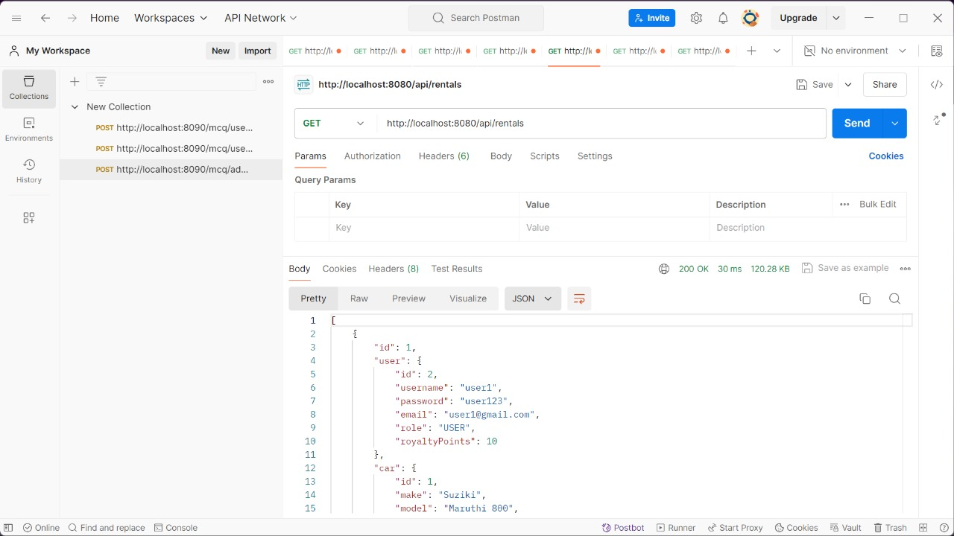
All Rentals:

Slide 35
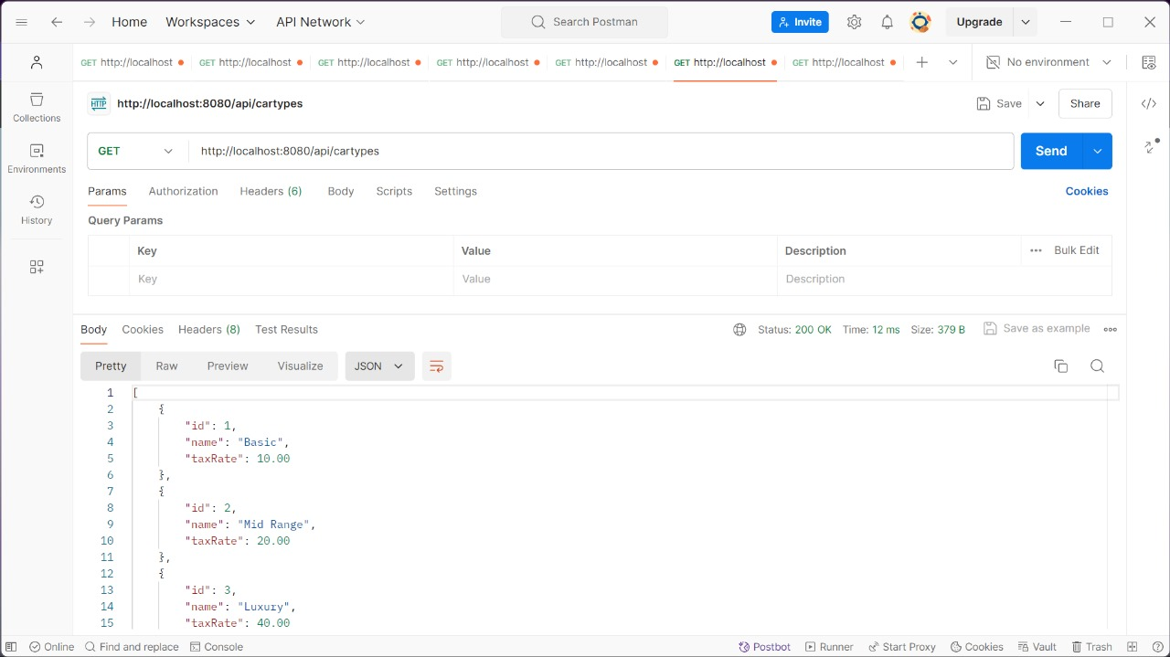
Car Types:

Slide 36
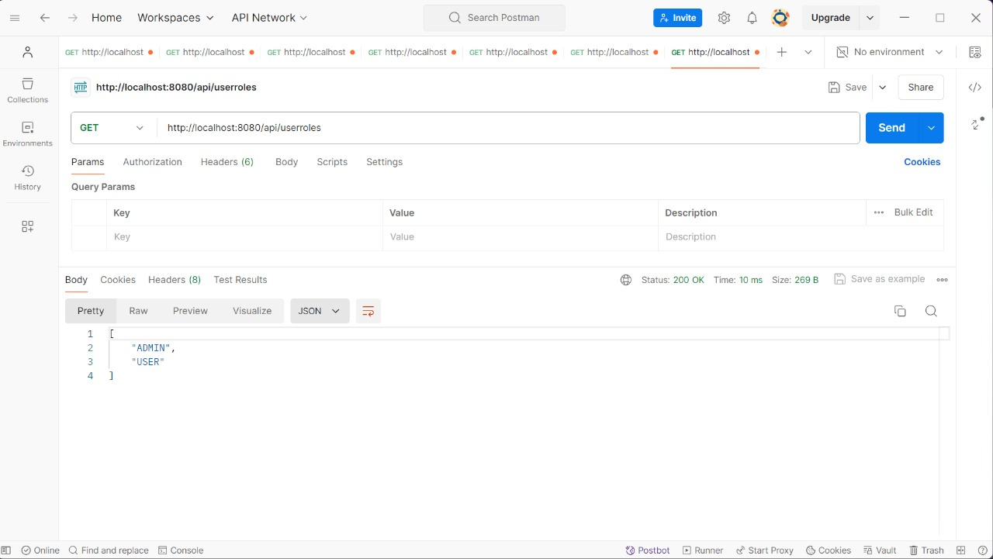
Roles Assigned:

Slide 37
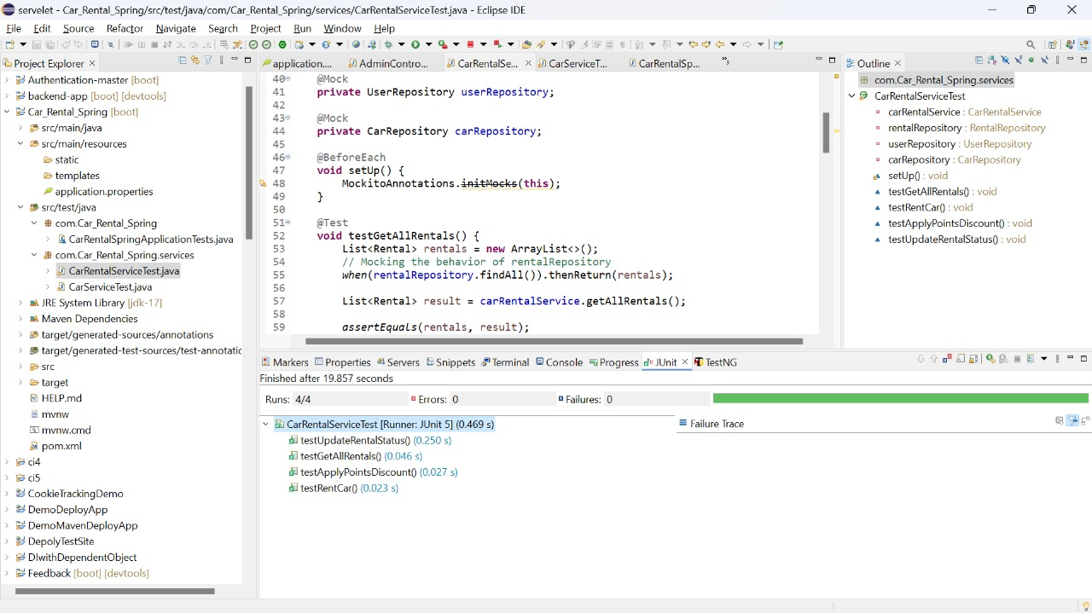
Junit Report:

Slide 38
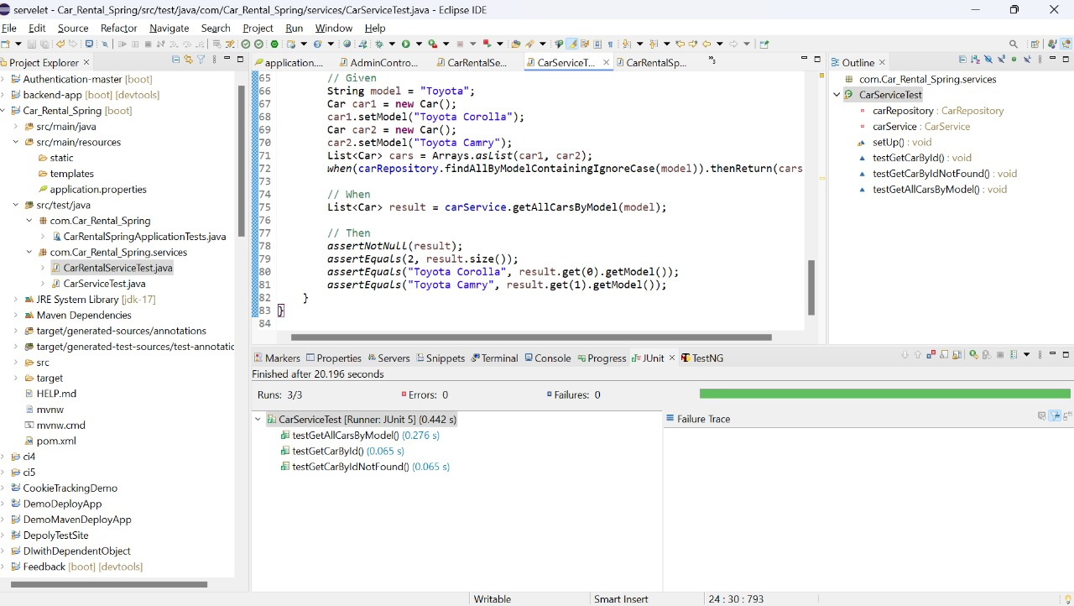
Junit Report:

Slide 39
Conclusion
The flexibility for administrators to update, add, or remove cars from the website ensures that it is always current.
Information that a user enters on the website to request a rental purchase will be stored.
The user-friendly interface of this software makes it possible to quickly view rental requests and customer data.
The "Car Search and Display" tool makes it easy and simple for consumers to browse and choose from our inventory of cars.
Github : https://github.com/RaghavaLagisetty/RLL_CarRentalApplication/tree/master

